Slide 1
Bottom-Up Parser

Slide 2
Bottom-Up Parsing
Creates the parse tree of the given input starting from leaves towards the root.
Tries to find the right-most derivation of the given input in the reverse order.
Also known as shift-reduce because its two main actions are shift and reduce.

Slide 3
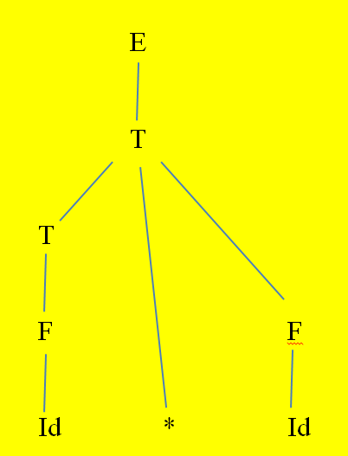
Ex: Consider the following Grammar:
E→E+T|T;T→T*F|F;F→(E)|id
Bottom up parsing of the input string “id * id “.
I/P String Sub String Reducing production
id*id Id F->id
F*id T F->T
T*id Id F->id
T*F * T->T*F
T T*F E->T
E --- Start symbol. Hence, the input String is accepted

Slide 4
Shift-Reduce Parser
A shift-reduce parser tries to reduce the given input string into the starting symbol.
RHS of a production rule is replaced by LHS(Non-terminal) of that production rule.

Slide 5
Handle
Handle of a string is a substring that matches the right side of a production rule.

Slide 6
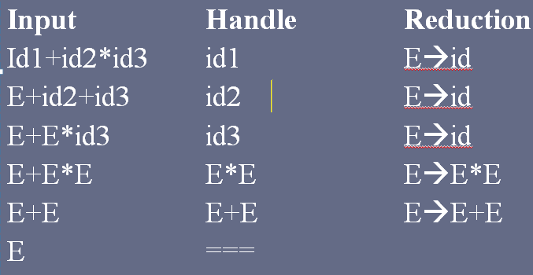
Ex: Consider the G, E→E+E, E→E*E, E→id Input string id+id*id.

Slide 7
Handle Pruning
A right-most derivation in reverse can be obtained by handle-pruning.

Slide 8
Stack Implementation
There are four possible actions of a shift-parser
Shift : The next input symbol is shifted onto the top of the stack.
Reduce: Replace the handle on the top of the stack by the non-terminal.
Accept: Successful completion of parsing.
Error: Parser discovers a syntax error, and calls an error recovery routine.

Slide 9
It can accept ambiguous grammars also.
Initial stack just contains only the end-marker $.
The end of the input string is marked by the end-marker $.

Slide 10
Ex: Consider the grammar to accept the input string
id * id, by using S-R parser E→E+T|T,T→T*F | F, F→(E)|id
Stack Input Action
$ id*id$ Shift
$id *id$ Reduce F→id
$F *id$ Reduce T→F
$T *id$ Shift
$T* id$ Shift
$T*id $ Reduce F→id
$T*F $ Reduce T→T*F
$T $ Reduce E→T
$E $ Accept

Slide 11
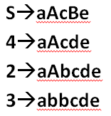
Ex2: Consider G S→aAcBe, A→Ab|b,B→d. Find the actions of SR parser for I/Pstring “abbcde”
Stack Input Buffer Action
$ abbcde$ Shift
$a bbcde$ Shift
$ab bcde$ A→b
$aA bcde$ Shift
$aAb cde$ A→Ab
$aA cde$ Shift
$aAc de$ Shift
$aAcd e$ B→d
$aAcB e$ Shift
$aAcBe $ S→aAcBe
$S $ ACCEPT

Slide 12
Shift-Reduce Parser
There are two main categories of shift-reduce parsers
Operator-Precedence Parser
→ Simple, but only a small class of grammars.
2. LR-Parsers\
→ Covers wide range of grammars.
SLR – simple LR parser
CLR – canonical LR parser
LALR – intermediate LR parser (lookhead LR parser)
SLR, CLR and LALR work same, only their parsing tables are different.

Slide 13
Operator-Precedence Parser
Small, but an important class of grammars
Only for an operator grammar.
Rules are
No ε at the right side
Two adjacent non-terminals at the right side.

Slide 14
Ex:
E→AB; A→a; B→b ➔ Not operator grammar
E→EOE; E→id; O→+|*|/ ➔Not ““
E→E+E | E*E | E/E | id ➔ Operator grammar

